Slide 1
.NET
An “Application Development Platform”.
It is developed by Microsoft Corporation in the year 2000.
.NET Stands for Network Enabled Technology.
.NET is a Package or SDK or Framework also called as ".NET Framework".
Used for powerful software application development.
It provides necessary environment (IDEs, compilers, run time engines, libraries) for developing efficient and powerful applications for the end-users.
.NET provides a distributed object oriented platform for building
Stand-alone Applications(Console & Winforms)
Web-based Applications
Service Applications
Mobile Applications

Slide 2
.NET FRAMEWORK
.NET Framework requires to run and develop any .NET Application
.NET Framework is a set of components, which are essential for develop and run any application in .NET Environment.
.NET Framework Consist of following Components.
Languages
Technologies
Base Class Libraries
CLR[Common Language Runtime]
Software written in .NET is managed code. Compiler compiles the source code to assembly consist of metadata and MSIL
JIT compiles MSIL to machine language which is called native code

Slide 3
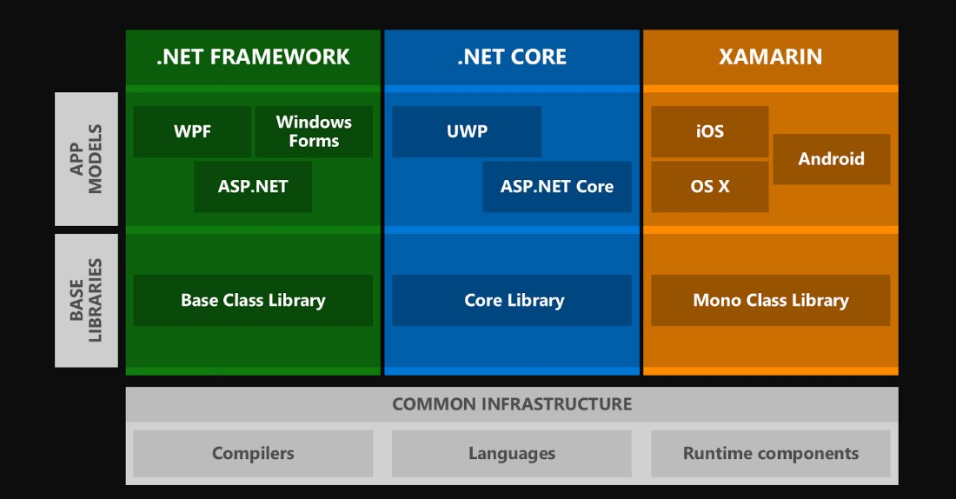
.NET Framework Architecture
Notes:
Share code, test and business logic across platforms.
Write cross-platform applications in C# with Visual Studio.

Slide 4
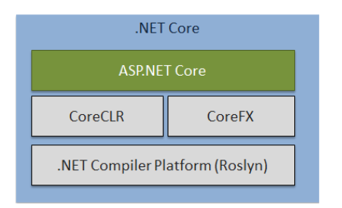
.NET Core Architecture

Slide 5
.Net Core
Open Source cross platform General purpose development environment introduced by Microsoft released under MIT licence.
.NET core can be run on Windows, Linux, and Mac OS
Having easy command line tools
Core CLR contains Ahead Of Time (AOT) compilation instead of the Just In Time (JIT) compilation
.cs/.vb
Roslyn
MSIL
CLR
Native Code
CoreFx

Slide 6
Visual Studio
IDE for creating .NET applications which are
Console based
Web based
Windows form based
Web services
Features
Page design
Automatic error detection
Debugging tools
IntelliSense (IntelliSense helps in auto completion by providing functions/methods names parameters etc.)
.

Slide 7
Environment Setup
Windows Platform(Windows 10)
Visual Studio.NET(2019) with .Net core 3.1
Web Server(IIS)(Internet Information Service)

Slide 8
C#
Programming Structure

Slide 9
About C#
C# is a programming language developed by Microsoft which is adhere to common language Infrastructure(CLI)
It is fundamentally a simple and object oriented language.
C# is part of Dot Net framework
C# is a type-safe, component-based, high-performance language
it supports structured error handling
it supports multi threading app development
it support to develop any type of app like console,windows,web etc.
Versions:1.0,2.0,3.0,4.0,5.0 up to 8.0

Slide 10
C# Program Structure
Structure of a C# program
using System;
namespace Namespace1
{
class Class1 { }
interface IYourInterface { }
delegate int YourDelegate();
enum YourEnum { }
}
namespace Namespace2
{
class YourMainClass
{
static void Main(string[] args)
{
//Your program starts here...
}
}
}
C# is case sensitive.
All statements and expression must end with a semicolon (;).
The program execution starts at the Main method.
Class, Namespace, method name to follow Pascal casing
Variables, parameters naming to follow Camel casing

Slide 11
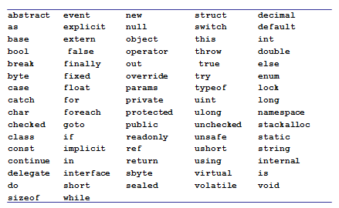
Keywords
Key words are predefined words that have special meaning for compilers like datatypes, modifiers, namespace, key words of operator,conversion,access specifier, literals

Slide 12
C# Data types
C# is a strongly typed language and so every variable must have a data type.
Data types in C# are of 2 types
Value types
Built in Data types like int, char, float ,double and user defined types like struct or enum
They are allocated in stack
Value types can not contain the value null.
Reference types.
User defined type created using class or interfaces
Reference types are allocated in heap at runtime.
Reference types can contain the value null

Slide 13
C# Value Types
Built in Types
Boolean type
bool
Integer types
byte int long sbyte short uint ulong ushort
Character type
char
Floating point types
decimal double float
User Defined Types
enum
struct

Slide 14
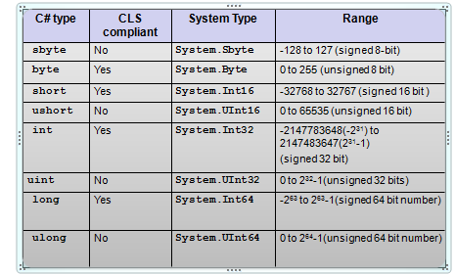
Integer types

Slide 15
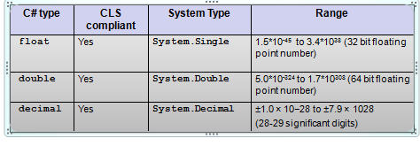
Floating point types

Slide 16
Floating-point literals
Floating-point literals can be written in two ways
Fixed notation: 3.14
Scientific notation: 0.314E1, 314e-2
Floating-point literal types
Literal with no suffix→ is double
Literal with F or f as suffix (Example 3.14f, 3.14F)→ is float
Literal with D or d as suffix (Example 3.14D, 3.14D) → is double
Literal with M or m as suffix (Example 3.14m, 3.14M) → is decimal
decimal d = 3.45; //error
decimal d = 3.45m; //ok
float f = 3.4;// error
float f = 3.4f;// ok

Slide 17
Character type and Character Literal
char keyword is alias for System.Char
It is CLS compliant.
char c=‘a’; //ok
char c=1; //error

Slide 18
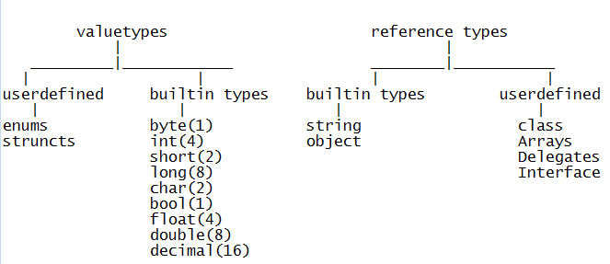

Slide 19
Reading inputs from the console
Console.ReadLine() Reads the next line of characters from the standard input stream.
Console.Read() reads a character and returns in the form of int.
using System;
class SayHello{
public static void Main(){
string s;
Console.Write("Please your name”);
s = Console.ReadLine();
Console.WriteLine(“Hello “+ s);
}}

Slide 20
Identifiers Naming Rules
Identifiers are variables, methods , class or any other named constructs in C#
Rules
Should not be a keyword
Must start with a letter or underscore or @
Subsequent characters can be a letter, number or underscore

Slide 21

Console output Formatting
Write statement can be used to print any type of variable.
Console output can be formatted using Write statement.
Example:
int intval=90;
double doubleval=9.99;
bool boolval=true;
Console.WriteLine("Double value= {1} \n
Int value= {0} \n Boolean value= {2} ",
intval, doubleval, boolval);
Specifies the argument index

Slide 22
Operators

Slide 23
Operators-Arithmetic
+ | - | / | * | ++ | -- | %
Most of the operators work the same way as it does in C.
Applicable to integer and floating point types
int i = 10;
int j = i+ 255;
byte k = i + 255; //error
const double PI = 3.14;
double f = PI + 12;
When 2 of any integral types (other than long) are involved in arithmetic operation, the result is an int.
byte i = 10;
byte j = 20;
j=j+i; //error

Slide 24
Operators-Relational
== | != | < | > | >= | <=
Relational operator return bool value – true or false.
int i=10;
int j=20;
Console.WriteLine( i>j ); // output is False
Console.WriteLine(i == 10); // output is True

Slide 25
Operators-Logical
&& | || | !
These are both boolean operators. These work only on bool values.
&& checks if the first condition is false. If it is so then it doesn't evaluate the second condition.
|| checks if the first condition is true. If it is so then it doesn't evaluate the second condition.
int i=0;
int j=2;
bool b= (i>j) && (j++>i);
Console.WriteLine(j);
What does the code print?

Slide 26
Assignment Operators
= | += | -= | *= | /= | %=
int a = 10;
int b=2;
a+=b; // 12 same as a=a+b;
Console.WriteLine(a);
double d=45.3;
d/=1.2;
Console.WriteLine(d); // 37.75 same as d=d/1.2
float d1=2.4f;
d1 %= 1.2f;
Console.WriteLine(d1); // 0

Slide 27
Other Operators
Operator | Name | Example
?: | Ternary operator | 10 % 2 > 0 ? 1 : 10
[] | Array subscript | a[1]
() | Cast
. | dot operator | n.Length
is | Type Conversion
as
typeof | In refection
new
checked
unchecked
=> | Lambda

Slide 28
Conversion

Slide 29
Conversions
Type conversion is a process of converting values from one data type to another data types
Conversion types:
Implicit Conversion
Casting
Boxing
Un Boxing

Slide 30
Implicit Conversions
Implicit numerical conversions
byte → short, int, long, float, double, decimal
char →int, long, float, double, decimal
short →int, long, float, double, decimal
int →long, float, double, decimal
long →float, double, decimal
float → double

Slide 31

Example
using System;
class Convert{
public static void Main(){
char c='A';
int i=c;
Console.WriteLine(i);
long l=23456789100;
float f=l;
Console.WriteLine(f);
}}
vice versa is not allowed implicitly

Slide 32
Casting
Any conversion that happens in the opposite direction of implicit numerical conversions requires explicit request from the compiler through casting.
Casting
Number casting example
long l2 = 12500;
int i2 = (int)l2;
int i = 256;
byte b1 = (byte)i;

Slide 33
Casting
floating point cast to int example
float f=12.f;
int i2 = (int)f;
Example 1:
float b1 = 1f; int b2 = 2;
float b3 = b1 + b2;
Example 2:
long b1 = 1; double b2 = 2;
double b3 = b1 + b2;
Example 3:
double b2 = 2;
int a3 = (int)b2;

Slide 34
Convert
Note that conversions of numeric value to string and vice versa, bool to string and vice versa etc. is not possible either implicitly or explicitly.
This can be done through the methods below:
Example:
/* Boolean values */
ii= Convert.ToBoolean("true");
Console.WriteLine(ii); //True
ii = Convert.ToBoolean("gg");
Console.WriteLine(ii); // Runtime error call //FormatException

Slide 35
Convert
/* String values */
string s= Convert.ToString(true);
Console.WriteLine(s); //True
s = Convert.ToString(1.23);
Console.WriteLine(s); //1.23
s = Convert.ToString('A');
Console.WriteLine(s); //A
Console.WriteLine(Convert.ToString(null));
// prints nothing
/* Numeric Values */
int i = Convert.ToInt32("1009");
short j = Convert.ToInt16("100");
long k = Convert.ToInt64("9292929");
byte b=Convert.ToByte("20");
No ToFloat method!
double d=Convert.ToDouble("sss"); // runtime error

Slide 36
Parse() Method
Another way to convert strings to basic type is by using System Type
Every System Type has Parse() method that can be used to convert a string into the respective System Type.
<Type>. Parse(string s)
Where <Type> could be any System Type/ C# type that we looked at earlier.
using System;
class ParseTest{
static void Main(string[] args) {
sbyte i1= sbyte.Parse("123");
float f1= float.Parse("123.3");
decimal d1= decimal.Parse("123.45");
bool b= bool.Parse("true");
Console.WriteLine("{0}, {1}, {2}, {3}, {4}, {5}, {6}", i1, f1, d1, b);
}}

Slide 37
Boxing And Unboxing
Boxing and unboxing allows a value-type to be converted to and from type object.
Converting a value type to reference type is called Boxing. Boxing is implicit conversion.
int i = 1;
object o = (object)i; // boxing
Or simply object o=i;
And reverse is unboxing
o = 1;
i = (int)o; // unboxing
Unboxing is explicit conversion.
When value-type are boxed they are stored in heap.
Boxing and unboxing are computationally expensive processes.

Slide 38
Conditional Statement & Loops

Slide 39
Decision constructs: if statement
if statement
if(Condition)
{
statements;
}
Condition must evaluate to bool value

Slide 40
Decision constructs: if-else statement
if/else statement
if(Condition)
{ statements; }
[
else{
statements;
}
]
Example: if (c > 0) c++; else c--;
Condition must evaluate to bool value

Slide 41
Decision constructs: switch statement
switch statement
switch(var)
{
case val1:
statements;
break;
case val2:
statements;
break;
……
default: statements;
break; }
Any numeric value or string
constants

Slide 42
Example
char c;
c = char.Parse(Console.ReadLine());
switch(c){
case 'r': Console.WriteLine("RED");
break;
case 'g': Console.WriteLine("GREEN");
break;
case 'b': Console.WriteLine("BLUE");
break;}
}
C# compiler enforces that every case statement must have a break statement. In other words control cannot fall through from one case label to another.

Slide 43
Multiple Cases
char c;
c = char.Parse(Console.ReadLine());
switch(c){
case 'r':
case 'R':Console.WriteLine("RED");
break;
case 'g':
case 'G': Console.WriteLine("GREEN");
break;
case 'b':
case 'B': Console.WriteLine("BLUE");
break;}
}

Slide 44
Looping Statements- for statement
There are two forms of for statement
for loop
for(intialization; condition;increment/decrement){
//statements
}
Ex: for(int i=0;i<10;i++)
foreach loop:
foreach(object variable in itemlist){
//statements
}
Ex: int[] arr={1,2,3,4,5};
foreach(int s in arr)
Console.WriteLine(s);

Slide 45
while and do while
// while loop
while(Condition) {
statements
}
Ex: int i=0;
while(i<10) {
Console.WriteLine(i);
i++; }
do-while loop
do{
statements
}while(Condition);
Ex: int i=0;
do {
Console.WriteLine(i);
i++;
} while(i<10);
Condition must evaluate to bool value

Slide 46
break and continue
Used with loop statements
break is used to break out of the loop. Is used with switch statement also.
continue is used to exit out of current iteration and continue with the next iteration.
int j = 100;
while (true)
{
if (j % 13 == 0) break;
else
j++;
}
Console.WriteLine(j); //104

